Slide 1
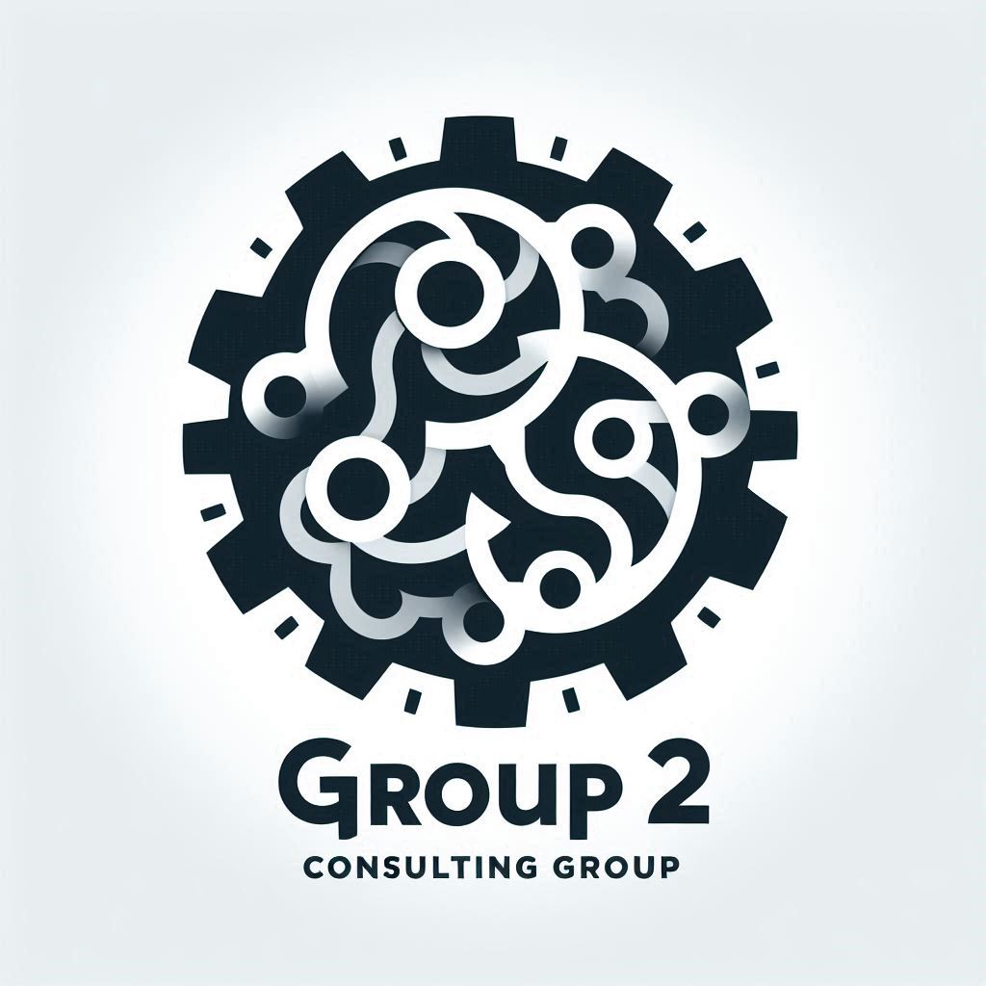
The Group 2 Consulting Group (G2CG)
…an AWS cloud solutions consultancy

Slide 2
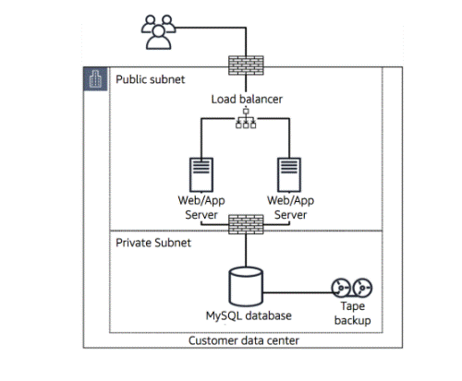
Project #1
Client
TechStyle Inc
Project
Optimization and modernization of CustomThread’s infrastructure to improve performance, ensure PCI compliance and reduce day-to-day management efforts
Client Must-Haves
Performance Optimization: application performs well during peak hours
Security and Compliance: Achieve PCI compliance; enhanced security
Scalability: Scalable architecture to handle future growth
Cost Optimization: Must be a cost-efficient solution
Low Maintenance: Requires minimal day-to-day management
Key Deliverables
Presentation of proposed solution – PowerPoint deck
Proposed architecture
Diagram
Describe how architecture addresses client’s must-haves
Security
High Availability and Redundancy
Cost Optimization

Slide 3
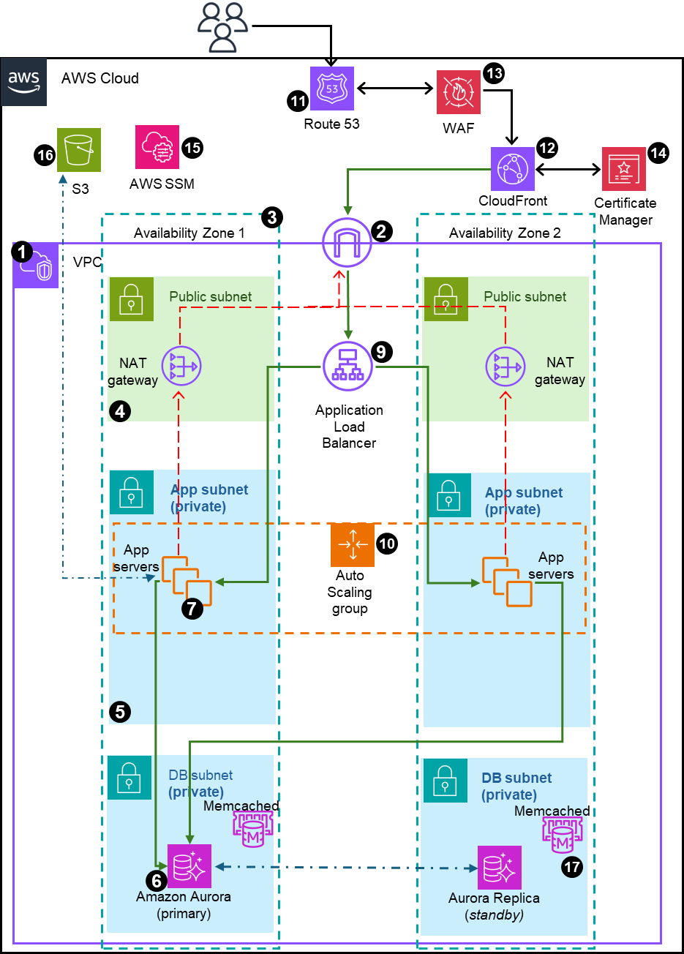
Description of architecture and high-level goals of solution
From Here
(on-prem)
To Here
(AWS Cloud)
Overview:
Goal is to replatform customthread’s current network infrastructure from on-premises to a low-maintenance AWS Cloud infrastructure, improving performance and ensuring enhanced security and PCI compliance.
Architecture was designed for:
Security
..

Slide 4
Description of Architecture Number Callouts
VPC with public and private subnets in 2 availability zones
Internet Gateway to allow communication between instances in VPC and internet
Two Availability Zones for high availability and fault tolerance
Public subnet to house resources like NAT gateway, Application Load Balancers and Bastion (we will replace bastion with SSM session manager)
App and DB servers will be placed in Private subnets
AWS Aurora with primary and replica mysql databases in different AZ to ensure high availability and resilience to failures
EC2 instances with the appropriate IAM roles and permissions to host web application
Amazon EFS to allow application to access shared storage ensuring persistent storage across instances
Application Load Balancer (ALB) to distribute traffic across an auto-scaling group of EC2 instances in multiple AZs.
Auto Scaling Group (ASG) to dynamically create EC2 instances to make web application highly available, scalable, fault-tolerant and elastic
Route 53 to set up DNS, direct traffic and domain management, and failover
CloudFront for global content caching, and SSL termination for data-in-transit encryption
WAF to protect application from web attacks that will compromise security consume resources and affect availability
Certificate Manager to create and manage the SSL/TSL encryption certification
Systems Manager to manage the resources – session manager for access (w/o need for ssh or bastion), patch manager for updates, etc
S3 to store static files, static website for failover, and back-up storage, and general storage
Other possible architecture considerations
Integrate monitoring and alerting – CloudWatch, etc
Improved governance – use AWS Control Tower to create Ous – Security OU, Test OU, DevOps OU and Production OU

Slide 5
Narrative: How this architecture resolves Custom Thread issues
High Availability and Redundancy
(multiple Azs, automatic backups, ALB, Replica DB)
Performance and Scalability (able to handle load at all times of the day, ASG, EFS for shared drive)
Security & PCI compliance for payment processing
SSL encryption
WAF to protect against attack
VPC to isolate and using security group rules, NACLs, private subnets and session manager (no ssh port) to improve security
IAM roles to connect to other AWS resources e.g. EC2 to DBs
Cost Optimization
Low Maintenance (minimal day-to-day management)
Other considerations
Latency improvement using CloudFront
Stickiness of sessions
S3 for static storage – backups, failover
Disaster recovery – backups of EFS in S3, backup of DBs
Backup and Recovery

Slide 6
Group 2’s Narrative
To solve CustomThread’s issues, Group 2 Consulting Group (G2CG) has proposed the following solution:
Migrate CustomThread from on-premise to AWS cloud
Performance and Scalability
Security:
Create a VPC to isolate the network; create public subnets and two private subnets

Slide 8
Group 2 Demo on AWS Console
VPC with public and private subnets in 2 availability zones
Internet Gateway to allow communication between instances in VPC and internet
Two Availability Zones for high availability and fault tolerance
Public subnet to house resources like NAT gateway, Application Load Balancers and Bastion (we will replace bastion with SSM session manager)
App and DB servers will be placed in Private subnets
AWS Aurora with primary and replica mysql databases in different AZ to ensure high availability and resilience to failures
EC2 instances with the appropriate IAM roles and permissions to host web application
Amazon EFS to allow application to access shared storage ensuring persistent storage across instances
Application Load Balancer (ALB) to distribute traffic across an auto-scaling group of EC2 instances in multiple AZs.
Auto Scaling Group (ASG) to dynamically create EC2 instances to make web application highly available, scalable, fault-tolerant and elastic
Route 53 to set up DNS, direct traffic and domain management, and failover
CloudFront for global content caching, and SSL termination for data-in-transit encryption
WAF to protect application from web attacks that will compromise security consume resources and affect availability
Certificate Manager to create and manage the SSL/TSL encryption certification
Systems Manager to manage the resources – session manager for access (w/o need for ssh or bastion), patch manager for updates, etc
S3 to store static files, static website for failover, and back-up storage, and general storage

